Slide 1
Welcome to the Threat Intelligence Table Top
CSA Threat Intelligence Emphasis
Aaron Anderson, Quincy Taylor

Slide 2
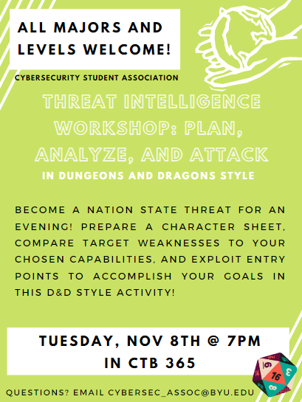

Slide 3
This has been built from the ground up. Please be patient with us and provide feedback through the survey at the end of the evening.

Slide 4
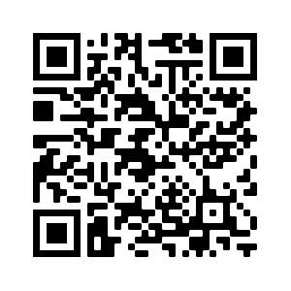
Event Attendance
See link in Slack Channel.

Slide 5
Instructions
Divide into teams of ~5
2 teams per DM/rooms (365/375)
Begin filling out character sheets depending on the assigned APT. (Use pencils)
Cozy Bear (Russia)
Mustang Panda (China)
Labyrinth Chollima (North Korea)
Ocean Buffalo (Vietnam)
Remix Kitten (Iran)
Venomous Bear (Russia)
Wicked Panda (China)
The Equation Group (USA)

Slide 6
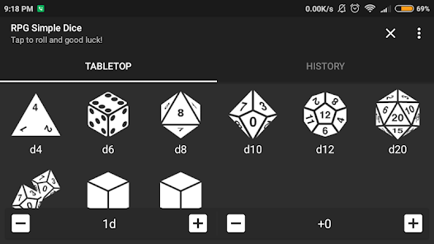
Download the RPG Simple Dice App

Slide 7
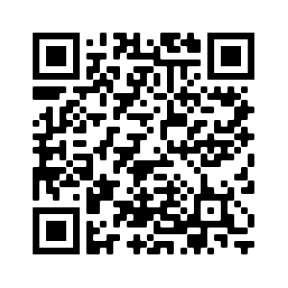
Event Feedback
See link in Slack Channel.
https://byu.az1.qualtrics.com/jfe/form/SV_bfGtNG8bCWeHO8S

